Slide 1
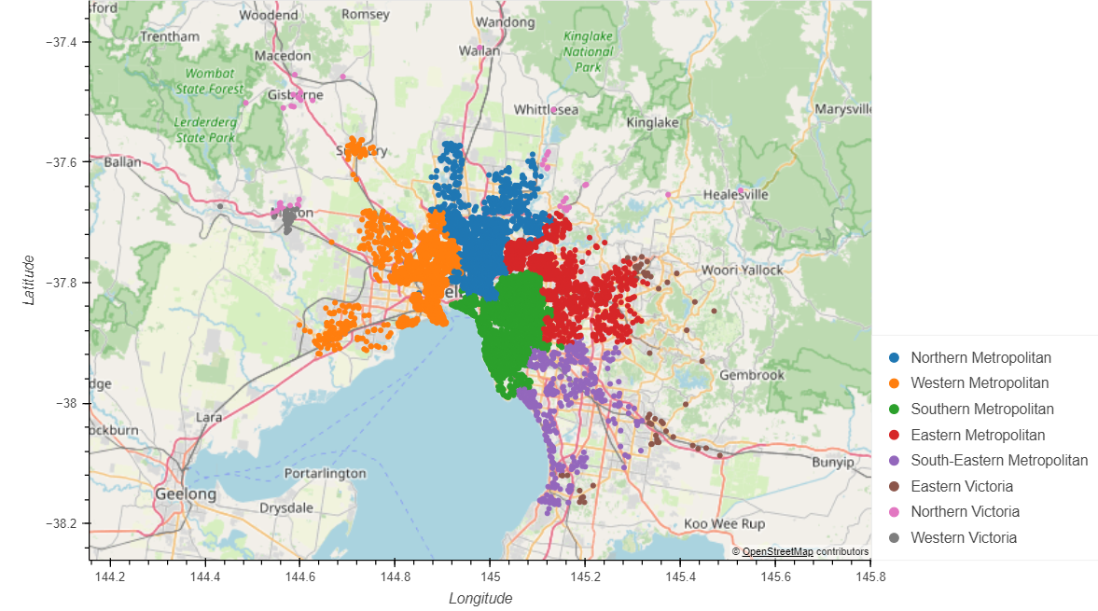

Market Dynamics
Sales per Region
Sales concentration are mainly in the metropolitan area, Specially in the Southern and Northen areas
Victoria Areas are the ones with the less transactions of all regions
Transactions are condensed in the area surrounding the Central Business District, the culture, business and dinning hub of the city

Slide 2
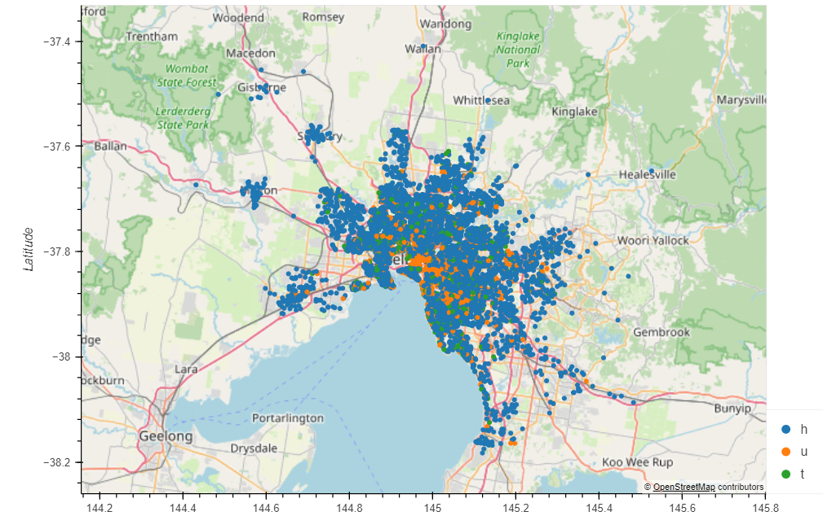
Market Dynamics
Sales per type of Real Estate
Most of the transactions are for home type of Real State even across regions
In the Southern metropolitan area close to the CBD there are more transactions for Units
The least transactions are done for Townhouses

Slide 3
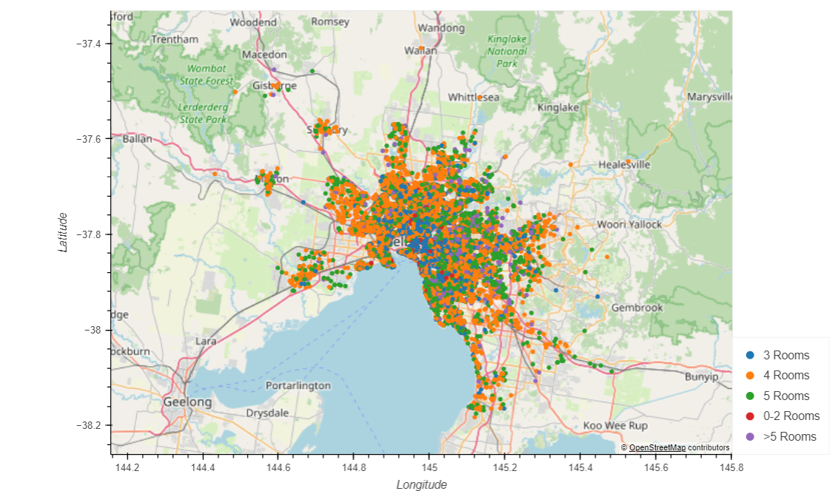
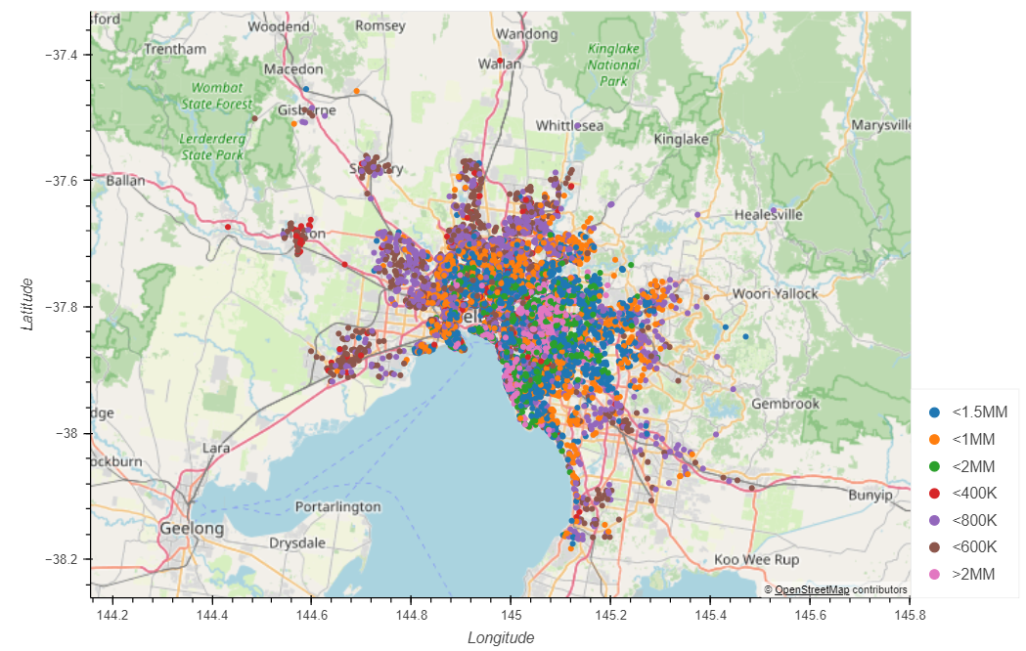
Market Dynamics
Sales per # of Rooms
Sales per Range of Price
Most of the transactions are for home with 3 and 4 Rooms, the lowest number of transactions are for 0-1 rooms and>5
Lower price transactions are on the most distant parts of the city including Victoria and the suburbs, the closest to the CBD the higher the price
There are very few transactions below 400K, almost 80% of the transactions are between $600K and $1.5MM
Super premium Real State +2.0MM represents 10% of the market

Slide 4
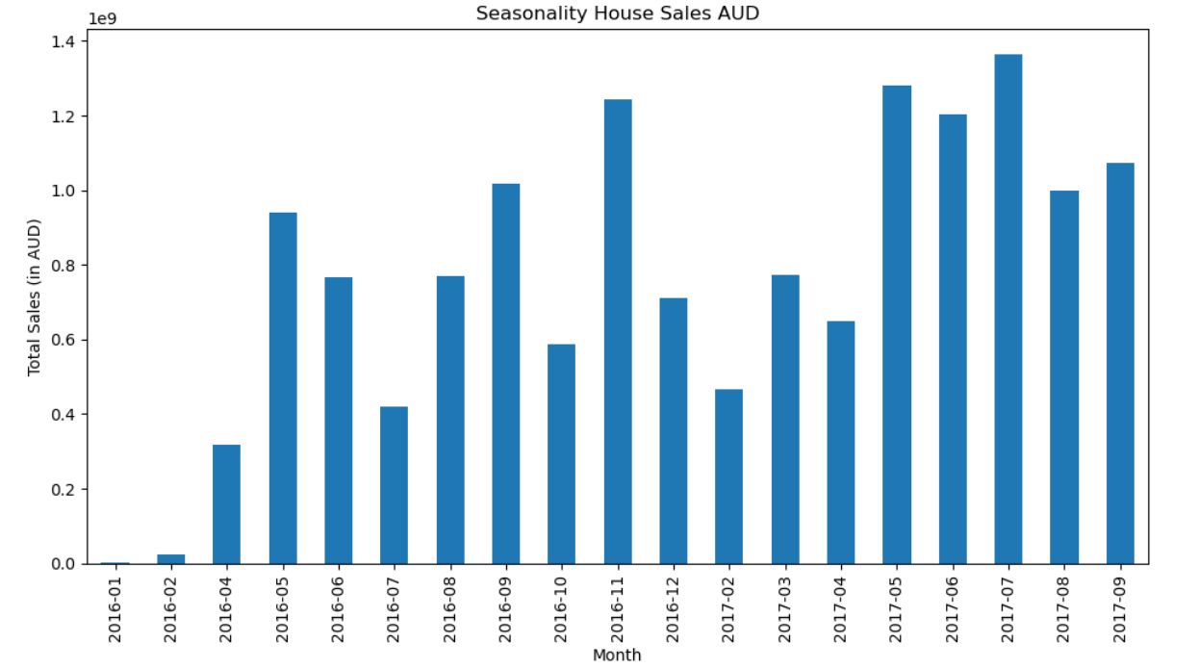
TOTAL Seasonality/trends of salES
We can observe 2 trends:
2017 sales have been higher than 2016 in total
first half of the year have lower sales so if you are a buyer you probably want to check this time of the year for a lower demand
Second half of the year is the most active time to move real estate in Melbourne

Slide 5
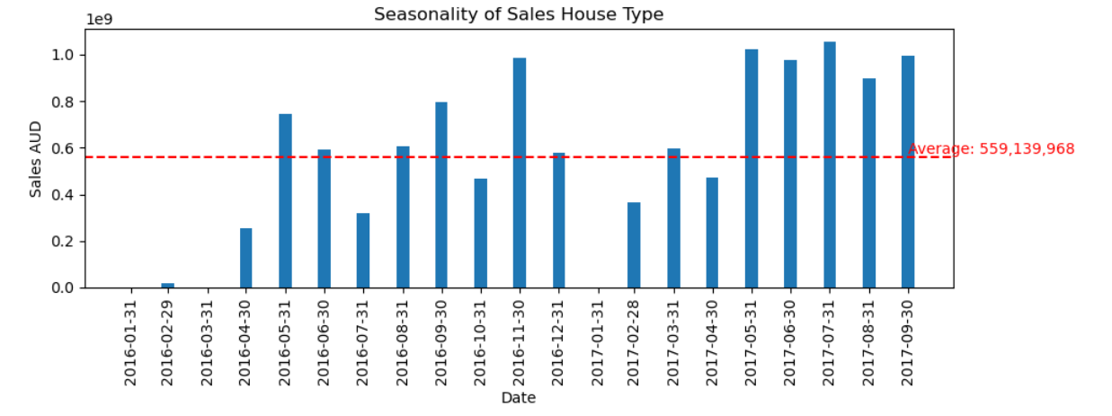
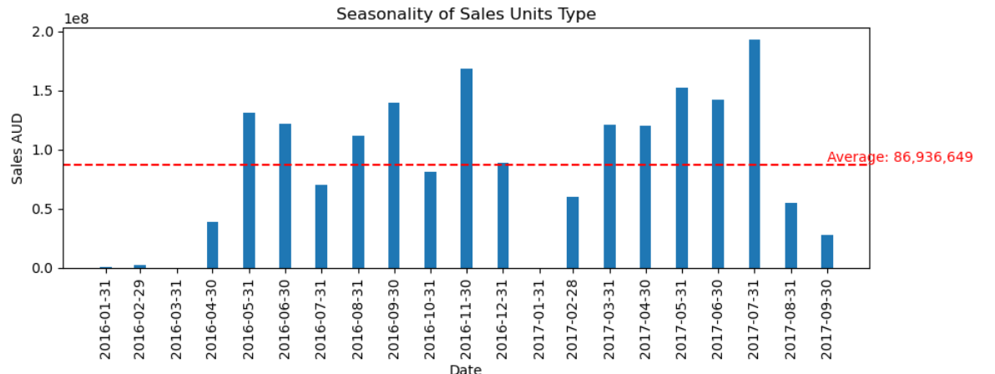
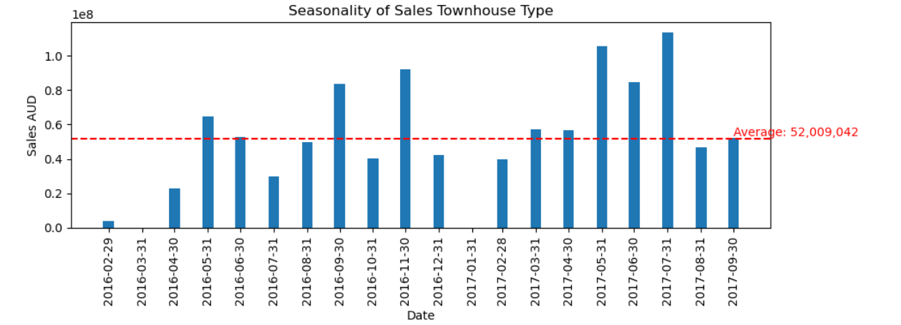
Seasonality/Trends of sales per TYpe
We observed:
Average sales for Houses are the highest its 10x Townhouses and 6x Units
Houses trend is higher for the second half of the year
Both Units and Townhouses sales have drop in the last 2 months

Slide 6
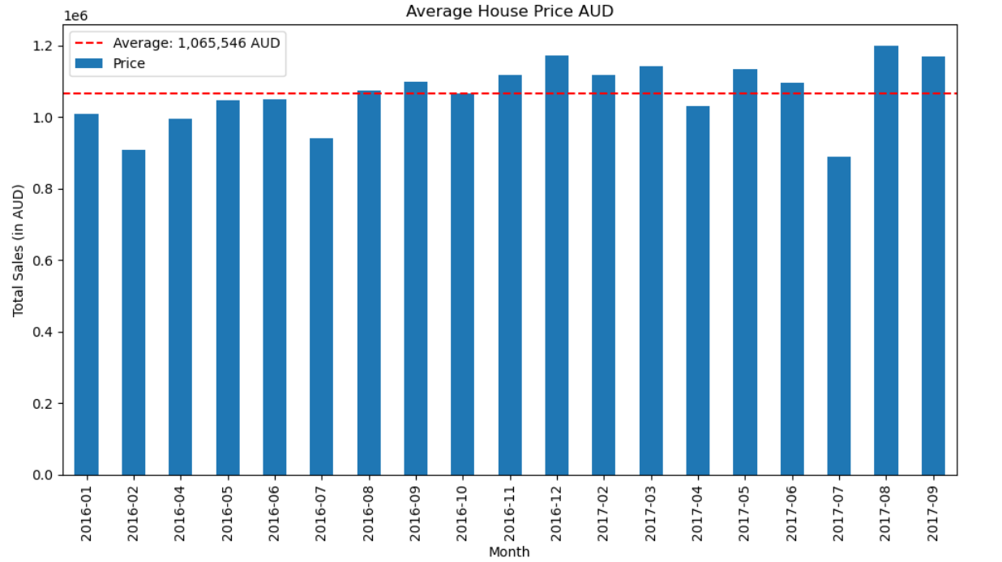
TOTAL Seasonality/Price of salES
We can observe 2 trends:
Average Price is $1MM for 2016 and 2017, months with higher demand are above average and slow months are lower, average has increased over last months except July 2017

Slide 7
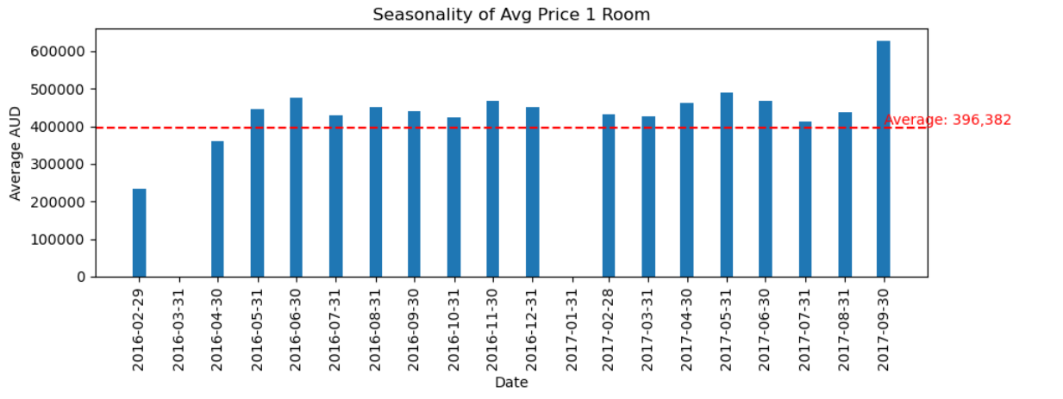
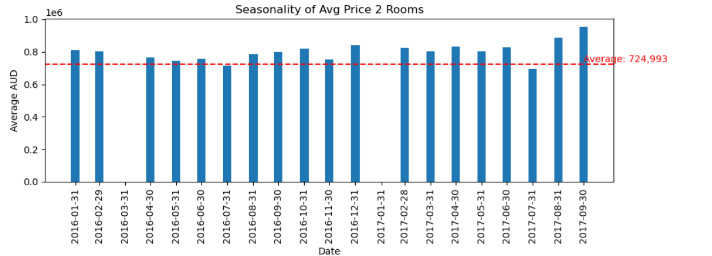
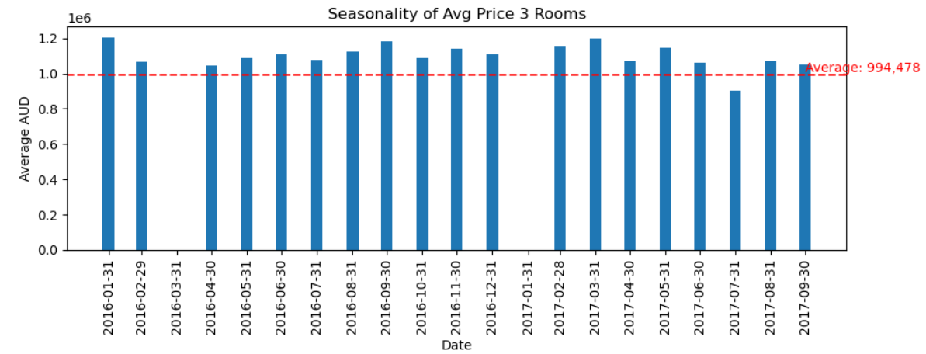
Seasonality/Trends of Price per Type Number of Rooms
We observed:
Average prices start at $396K if you want to buy 1 Bedroom apartment that would the lower end of the budget.
There is a big jump from 2 Rooms to 3 Rooms average price, it requires almost $300K more for an average price of almost $1MM
Prices are stable price has increased in the last few months for ! Room and 2 rooms. However, prices for 3 Bedroom have a downward trend

Slide 8
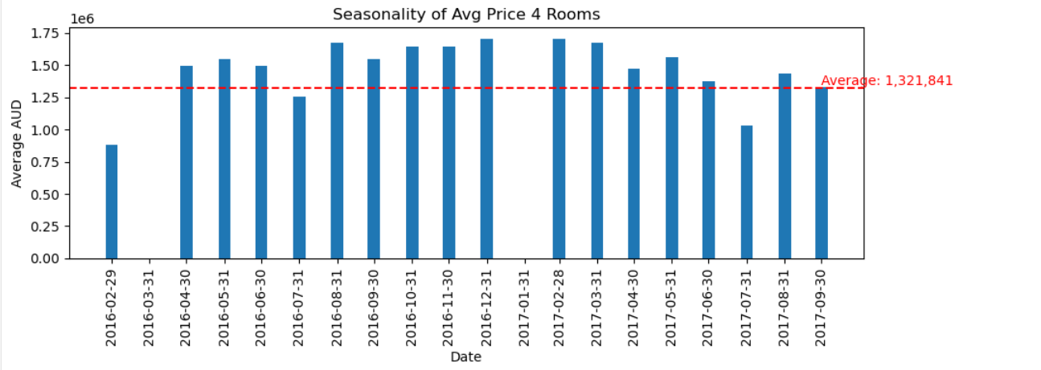
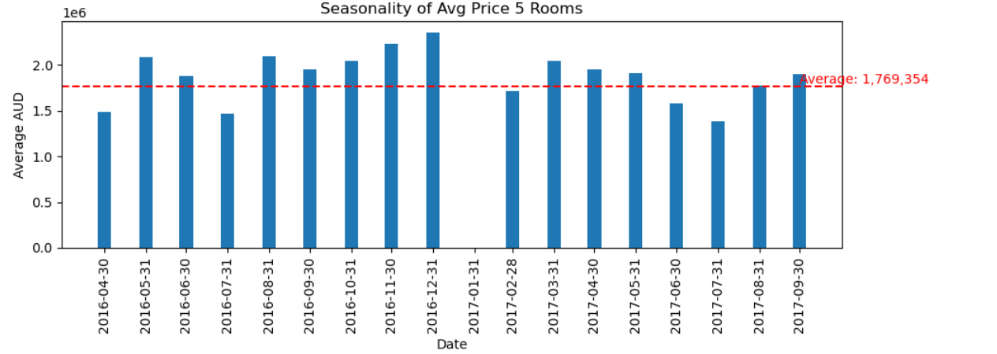
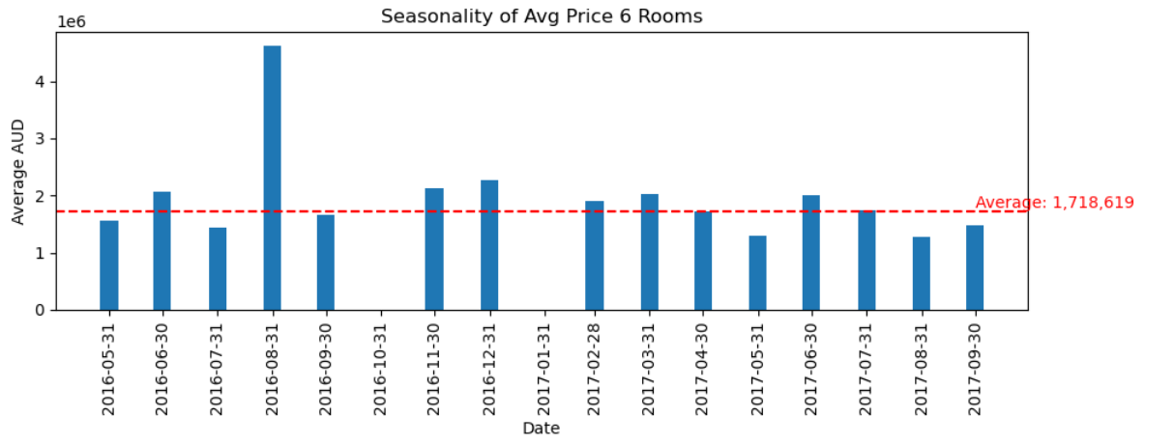
Seasonality/Trends of Price per Type Number of Rooms
We observed:
Average price for larger Real Estate have a range between $1.3 and $1.7MM
There are more transactions for 4 and 5 rooms than 6 rooms homes
4 and 5 room homes prices are declining while 6 rooms real estate average prices are more volatile.

Slide 9
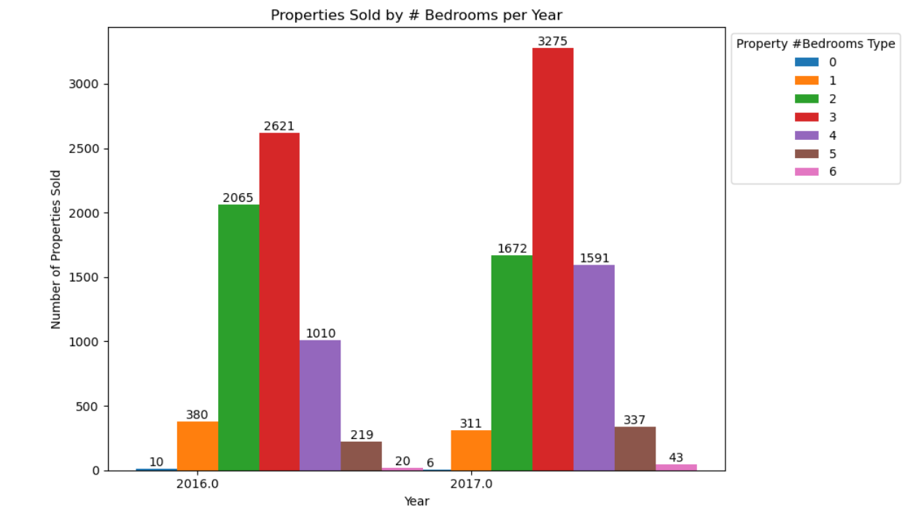
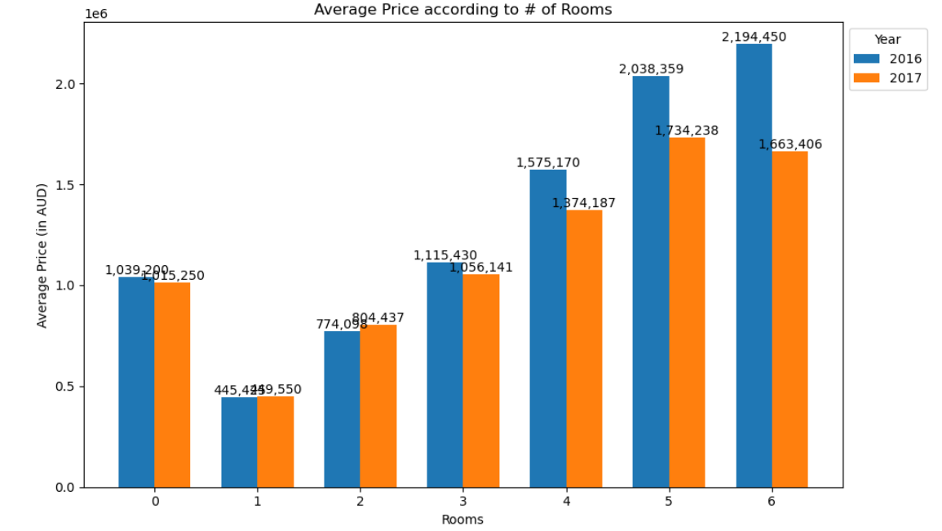
Seasonality/Trends of SALES and Price per Type Number of Rooms
We observed:
Transactions are higher for 2, 3 and 4 rooms, they make the 80%
Most transactions per type of homes per rooms growth in 2017, specially 3 rooms. Only 1 room transactions are declining vs. prior year
During 2017 average prices have been impacted for most of the properties, only 2 room real estate have increased its prices

Slide 10
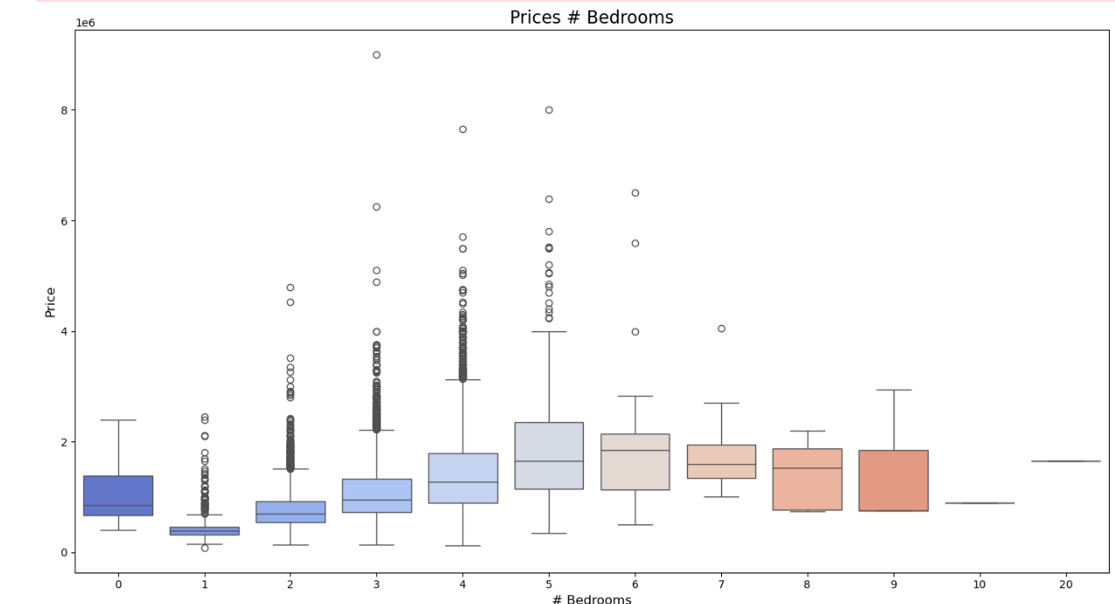
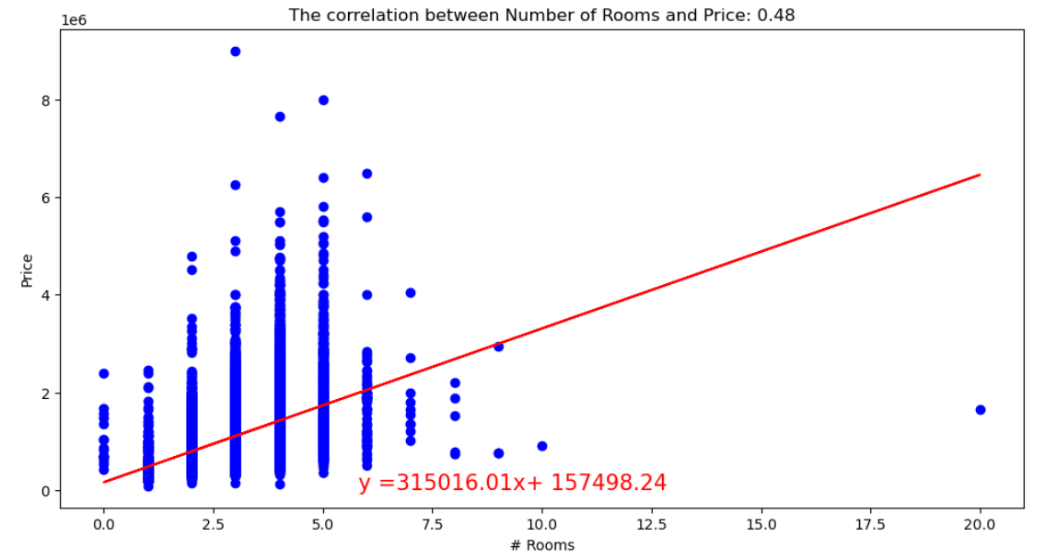
Prices and number of bedrooms relationship
We observed:
Prices increase with the number of bedrooms in the homes, generating a moderate correlation with price of 0.48
Prices are very dispersed for 2, 3 and 4 rooms houses, suggesting there is another better variable to predict the prices
Zero rooms real state holds a higher avg price than the 1 room homes.

Slide 11
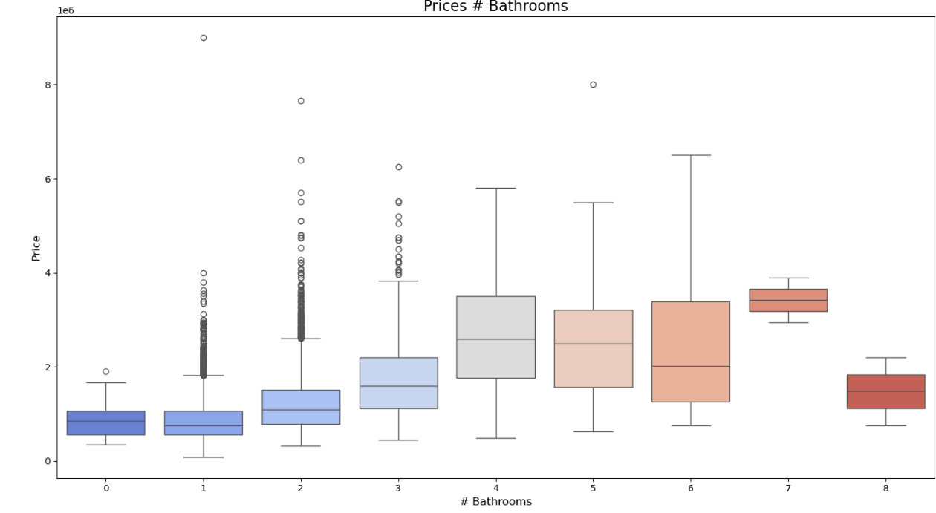
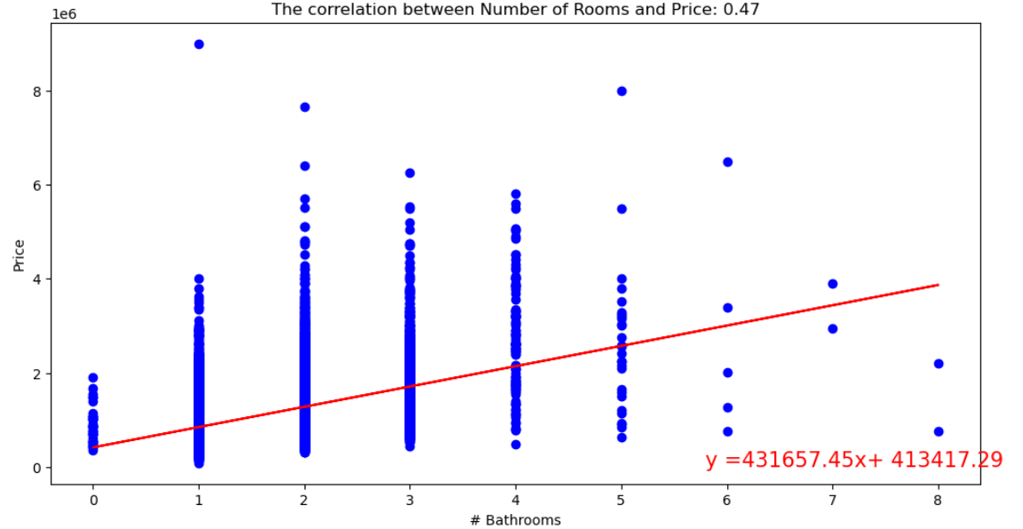
Prices and number of bedrooms relationship
We observed:
There is no price changes between 0 and 1-bathrooms, however having 3 or 4 bathrooms implies impact to the average price.
Prices increase with the number of bathrooms in the homes, generating a moderate correlation with price of 0.47
Prices are more dispersed for 2-bathroom homes.

